Slide 1
Atlanta Liu
Maruthi Mutnuri
Edwin Aguirre
Greg Cameron
November 2019

Slide 2
Exponential Growth in Data
(1 trillion gigabytes!)
The 4 V’s of Big data
Volume
Velocity
Variety
Veracity

Slide 3
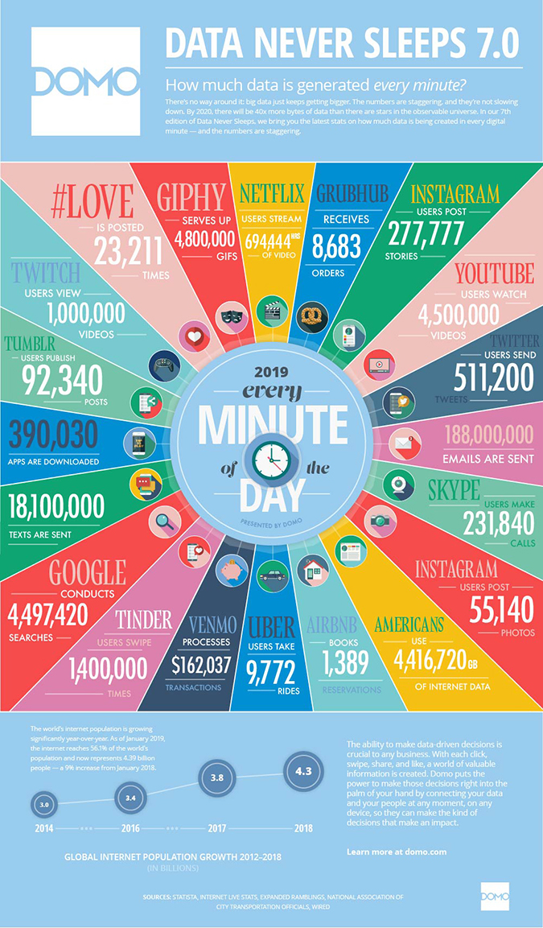
Exponential Growth in Data
Over 1 billion TB!
The 4 V’s of Big data
Volume
Velocity
Variety
Veracity
https://www.domo.com/learn/data-never-sleeps-7

Slide 4
How do we add value with all this data?
Over 1 billion TB!
Real-time, reliable results
streaming data
efficient parallel processing
fault handling
Straightforward coding
good libraries on several platforms
Actionable insights!
machine learning
useful visualizations
https://www.domo.com/learn/data-never-sleeps-7

Slide 5
Overview
Open-source cluster-computing framework
Developed in UC Bekeley’s AmpLab in 2009
Donated to Apache Software Foundation in 2013, first release in 2014
Developed to enable real-time processing of large/streaming datasets
Real-time results!

Slide 6
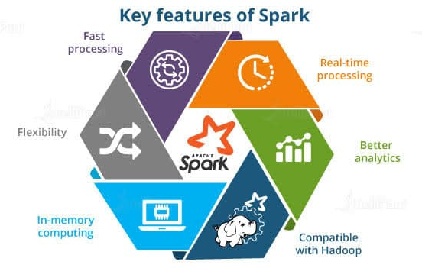
Features
Distributes data to memory
Up to 100x faster than reading from disk
Cross-platform
Hadoop, Apache Mesos, Kubernenetes, stand-alone or in the cloud
Multiple languages
Java, R, Scala, and Python
Rich set of libraries
Enable large variety of processing
From https://intellipaat.com/blog/tutorial/spark-tutorial/spark-features/

Slide 7
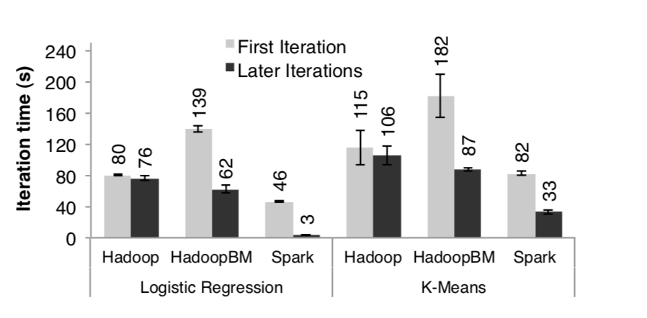
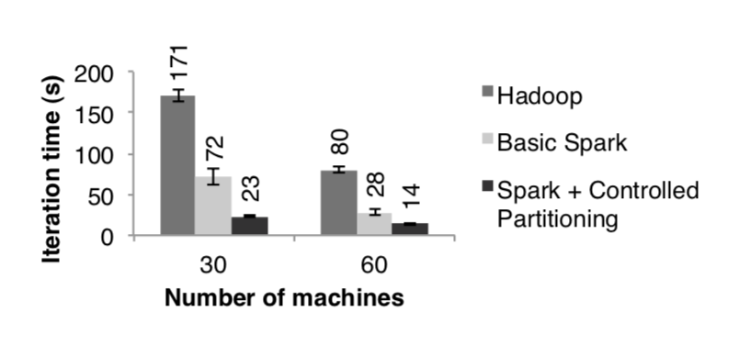
Performance
Spark outperforms Hadoop by up to 20x in iterative machine learning applications.
avoids I/O and deserialization costs by storing data in memory as Java objects
Spark can be used to query a 1 TB dataset interactively with latencies of 5–7 seconds
Machine Learning Example
Page Rank Example
http://people.csail.mit.edu/matei/papers/2012/nsdi_spark.pdf

Slide 8
RDDs (Resilient Distributed Datasets)
Fundamental Data Structure of Apache Spark
Immutable
Parallel Data Structures
Are represented by coarse-based transformation (i.e. map,filter and join) that are applied to datasets
RDDs can only be created through deterministic operations (transformations) on Data or from other RDDs. Hence, the RDDs are not an actual dataset but a transformation representation of a dataset.
Fault tolerant

Slide 9
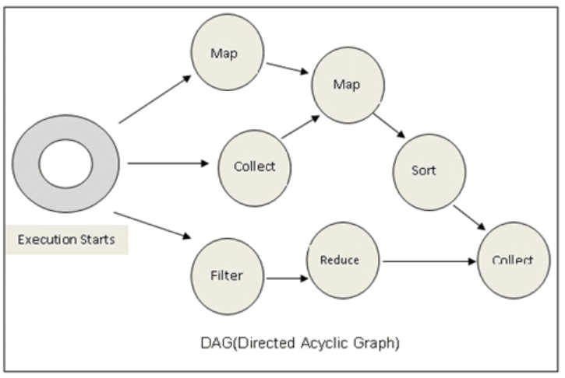
DAGs (Directed acyclic graphs)
DAGs provides workflow to RDDs
Structure that is used to model pairwise relations between objects
Components of graphs are vertices(nodes or points) which are connected by edges (links or lines)
DAGs have edges with directions and connect their vertices sequentially.
Apache Spark uses DAGs to represent vertices as RDDs, and edges as transformations performed to RDDs.

Slide 10
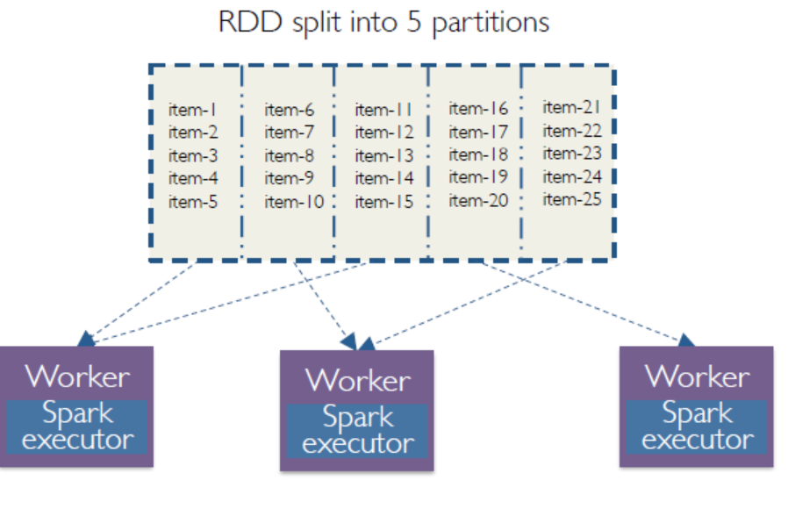
Partitions
Data size that is big in size, needs to be “partitioned” or sliced across different nodes/machines
Number of partitions is chosen by the user
https://medium.com/@thejasbabu/spark-under-the-hood-partition-d386aaaa26b7

Slide 11
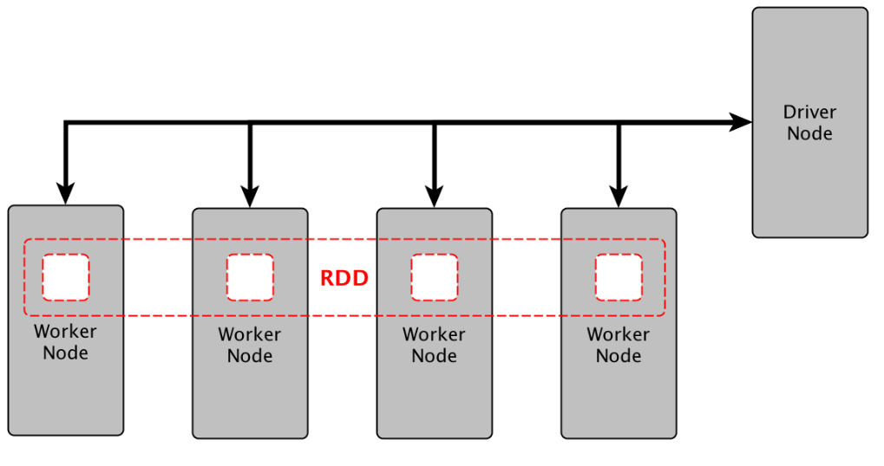
Parallelized
Functions applied to the dataset can be run simultaneously to each “slice” or “partition”.
https://medium.com/@lavishj77/spark-fundamentals-part-2-a2d1a78eff73

Slide 12
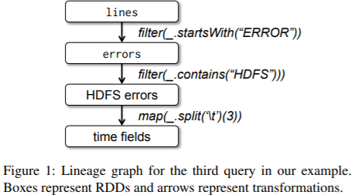
Fault Tolerance/Failure Recovery
The previously mentioned coarse grained transformation allows for easy “fault tolerance” as they are logged (called a lineage).
If a node fails, the task manager then runs the lineage to restore information across all nodes
Partitioned RDDs have enough information about how other partitions were derived, so lost data can be easily recovered
http://people.csail.mit.edu/matei/papers/2012/nsdi_spark.pdf

Slide 13
Spark’s Libraries
https://intellipaat.com/blog/what-is-apache-spark/

Slide 14
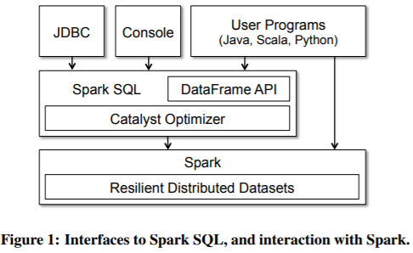
SQL and DataFrames
Uses two main concepts:
DataFrame API
Catalyst optimizer
The DataFrame API uses a collection of objects from Java and Python
The Catalyst optimizer contains a general library, which represents trees and applies different rules to transform them
The library runs on top of Spark as shown in picture
http://people.csail.mit.edu/matei/papers/2015/sigmod_spark_sql.pdf

Slide 15
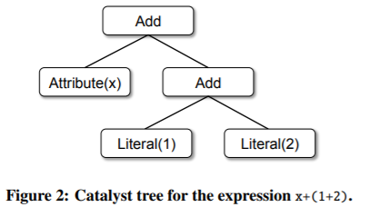
SQL and DataFrames
The Catalyst’s main Data type is a tree, which is composed of a node type objects
Trees can be modified by functional transformations, and are able to communicate from one tree to another
Tree Objects are Immutable
Spark SQL uses the Pattern matching function/rule that allows for the extraction of values from nested structures of algebraic types.
http://people.csail.mit.edu/matei/papers/2015/sigmod_spark_sql.pdf

Slide 16
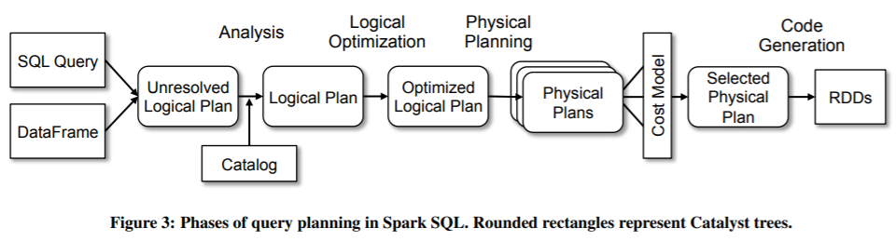
SQL and DataFrames
Catalyst’s transformation tree is used in four phases.
Analysis: rule-based optimization performed when there are any unresolved relations or references
Logical Optimization: rule-based optimization, to the already build “Logical Plan”
Physical Planning: cost-based optimization, that chooses the best model based on a cost model
Code Generation: Uses “quasiquotes”, to produce code efficiently in Java bytecode
http://people.csail.mit.edu/matei/papers/2015/sigmod_spark_sql.pdf

Slide 17
Machine Learning Library(MLlib)
Provides fast distributed implementations of common learning algorithms, which are: linear models, naïve Bayes, decision trees, and k-clustering
Provide many algorithms optimizations, such as the ALS algorithm, to improve on linear algebra operations
Provides with Machine learning pipelines , which can be often described as workflows that involve sequentially data preparation, feature extraction, model fitting and validation stages.
Provides with robust documentation, it also provides with a list of codes dependencies.

Slide 18
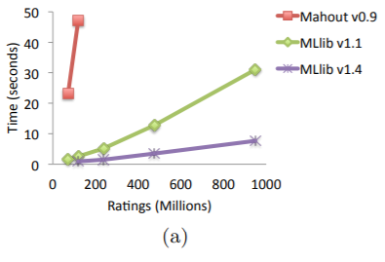
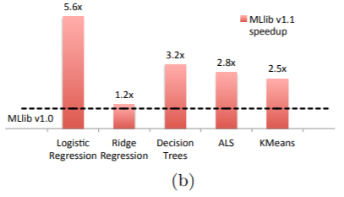
Machine Learning Library(MLlib)
MLlib’s 1.4 version is faster than MLlib’s version 1.1. Also, it can be observed that when using Apache’s Mahout v0.9 (which runs Hadoop MapReduce), the computational time is substantially slower than any of MLlib’s versions. The benchmark used for this graph was the ALS algorithm.
MLlib v1.1 relative improvement over MLlib 1.0 , it can be observed that there was on average 3.0x improvement on different algorithms
http://www.jmlr.org/papers/volume17/15-237/15-237.pdf

Slide 19
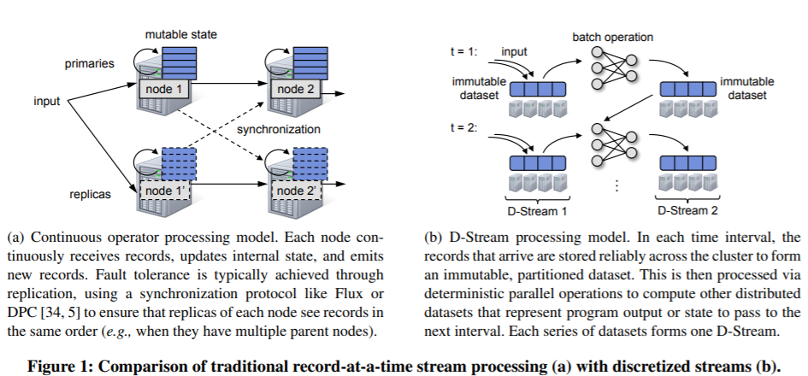
Spark Streaming
Proposes new streaming model than the well known “continuous operator” model
New model avoids regular problems by structuring computations as a set of short, stateless, deterministic tasks, rather than continuous operators. These objects are called discretized streams.
http://people.csail.mit.edu/matei/papers/2013/sosp_spark_streaming.pdf
Notes:
Streaming computations are treated as a series of deterministic batch computations over small time intervals

Slide 20
GraphX – Intro to Graph Data
Graph Data
Graphs – consist of nodes and edges
Nodes contain entities
Edges contain relationships
Most social media data are graph data
Graph-parallel systems
Optimized for graph-based data (NoSQL)
http://ampcamp.berkeley.edu/big-data-mini-course/graph-analytics-with-graphx.html

Slide 21
Library: GraphX
Distributed graph framework that unifies graph-parallel and data-parallel computation
Data can be viewed as both graphs and tables
Uses two RDDs - edge collection, vertex collection
Allows end-to-end pipeline of graph and table operations without moving the data
Less efficient on pure graph-parallel workflows
More efficient on combined graph-parallel and data-parallel workflows
https://spark.apache.org/docs/0.9.0/graphx-programming-guide.html

Slide 22
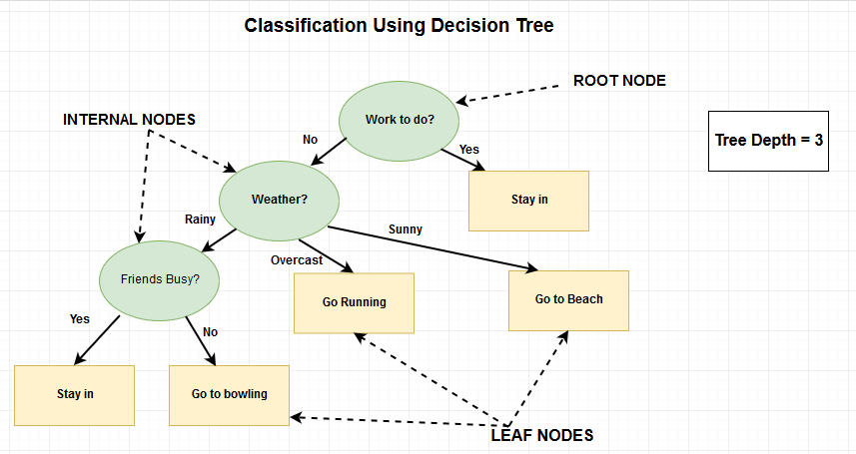
Technical Demonstration: ML Lib - Decision Tree

Slide 23
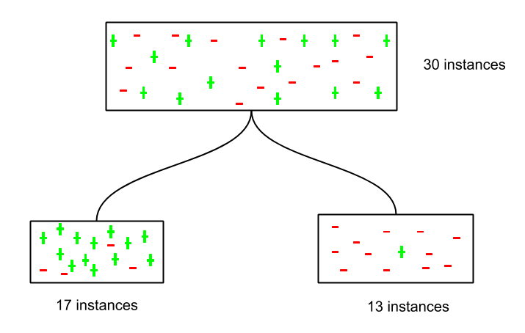
Decision Tree - Purity

Slide 24
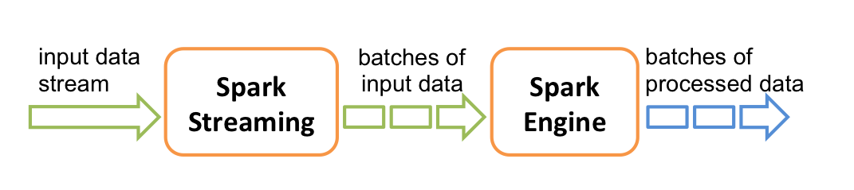
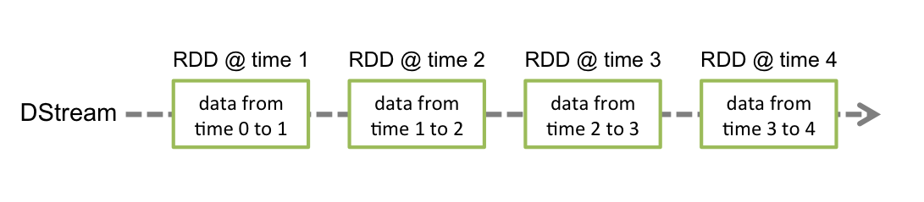
Technical Demonstration: Spark Streaming
https://spark.apache.org/docs/latest/streaming-programming-guide.html

Slide 25
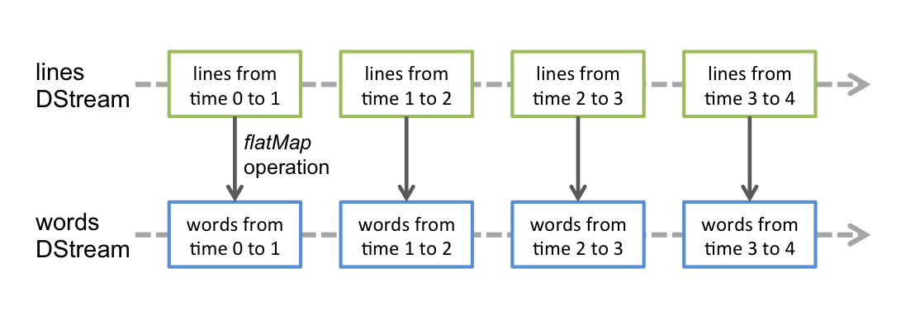
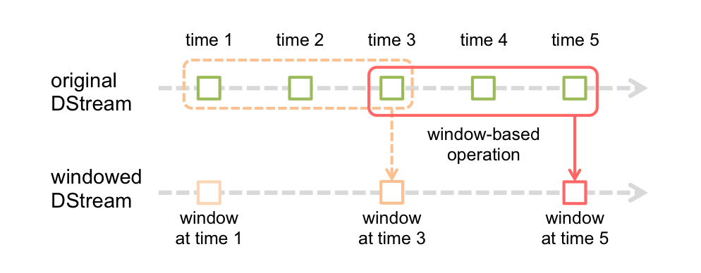
Technical Demonstration: Spark Streaming
https://spark.apache.org/docs/latest/streaming-programming-guide.html

Slide 26
Need for Streaming Applications
Real-time Sentiment Analysis – based on social media posts (facebook, twitter, etc.)
Real-time Fraud Detection of bank transactions
Use Cases
Netflix
captures all member activities to personalize recommendations
processes 450 billion events per day
MyFitnessPal
used to build their data pipeline, create a list of ‘Verified Foods’
provided a ten-fold speed improvement over their previous data pipeline
Notes:
As you can see from above scenarios, spark streaming continuously receives input data stream and uses spark engine to process it to generate output data stream.

Slide 27
Use cases
Apache Spark at MyFitnessPal
The largest health and fitness community MyFitnessPal helps people achieve a healthy lifestyle through better diet and exercise. MyFitnessPal uses apache spark to clean the data entered by users with the end goal of identifying high quality food items. Using Spark, MyFitnessPal has been able to scan through food calorie data of about 80 million users. Earlier, MyFitnessPal used Hadoop to process 2.5TB of data and that took several days to identify any errors or missing information in it.
Netflix
Netflix uses Apache Spark for real-time stream processing to provide online recommendations to its customers. Streaming devices at Netflix send events which capture all member activities and play a vital role in personalization. It processes 450 billion events per day which flow to server side applications and are directed to Apache Kafka.
https://www.dezyre.com/article/top-5-apache-spark-use-cases/271

Slide 28
Key Take-Aways
With more data being created all the time and users requiring real-time results, we need methods that can process big data quickly
Spark distributes data to memory – up to 100x faster than reading from disk
Rich set of libraries enable large variety of processing
Enabled by RDDs (Resilient Distributed Arrays)
Read only, partitioned collection of records that are fault-tolerant

Slide 29
Interactive Component
Speed Comparison: MapReduce vs Spark

Slide 30

TV
TV
Map Reduce 1
Map Reduce 2
Spark 1
Spark 2
Whiteboard 1
Whiteboard 2

Slide 31
Instructions
Each worker will take 20 candies from the bin in the middle
Task 1: Group candies by category
Task 2: Count candies
Task 3: For each category, perform the following actions:
- If candy count in Lollipop is even, discard all Lollipop candies
- If candy count in Chocolate Minibar is odd, add an extra Chocolate Minibar candy to your pile
- If candy count in Kerr’s Toffee is even, remove one Kerr’s Toffee candy from your pile
Task 4: Sum Total Candy (Regardless of Category)
Category | Lollipop | Chocolate Minibar | Kerr’s Toffee
Count | 8 | 9 | 3
Count (after action) | 0 | 10 | 2
Sum Total | 12 (0 + 10 + 2)

Slide 32
Debrief
Speed Comparison: MapReduce vs Spark

Slide 33
References
PySpark Installation Guide and Jupyter notebooks – available on D2L
Spark website
https://spark.apache.org
Key technical papers
M. Zaharia, M. Chowdhury, T. Das, A. Dave, J. Ma, M. McCauley, M. J. Franklin, S. Shenker, and I. Stoica, “Resilient distributed datasets: a fault-tolerant abstraction for in-memory cluster computing”, NSDI '12 Proceedings of the 9th USENIX conference on Networked Systems Design and Implementation, pp. 2-2, April 2012. Available: http://people.csail.mit.edu/matei/papers/2012/nsdi_spark.pdf
Matei Zaharia, Tathagata Das, Haoyuan Li, Timothy Hunter, Scott Shenker, Ion Stoica. “Discretized Streams: Fault-Tolerant Streaming Computation at Scale.” SOSP 2013. November 2013. Available: http://people.csail.mit.edu/matei/papers/2013/sosp_spark_streaming.pdf
X. Meng,J. Bradley, B.Yavuz,E.Sparks,S.Venkataramn, D.Liu,J.Freeman,DB Tai, M. Made, S.Owen, D. Xin, R.Xin,M. Franklin, R.Zadeh, M.Zaharia, A. Talwalkar, “MLlib: Machine Learning in Apache Spark”,Journal of Machine Learning Research (2016), pp.1-7, May, 2015. Available: http://www.jmlr.org/papers/volume17/15-237/15-237.pdf
M. Armburst, R. S. Xin, C. Lian, Y. Huai, D. Liu, J. K. Bradley, X. Meng, T. Kaftan, M.J. Franklin, A. Ghodsi, M. Zaharia, “Spark SQL: Relational data processing in Spark”, SIGMOD 2015, June 2015. Available: http://people.csail.mit.edu/matei/papers/2015/sigmod_spark_sql.pdf
R.S. Xin, D. Crankshaw, A. Dave, J. E. Gonzalez, M. J. Franklin, and I. Stoica, “GraphX: Unifying data-parallel and graph-parallel analytics”. Arxiv, Feb. 2014. Available: https://amplab.cs.berkeley.edu/wp-content/uploads/2014/02/graphx.pdf

